Slide 1







Nov 2026 - University of Crete
Machine Learning for Bioinformatics
Panagiotis Alexiou, PhD
University of Malta

Slide 2
Machine Learning for Bioinformatics
What is Machine Learning?

Slide 3


Slide 4


Slide 5
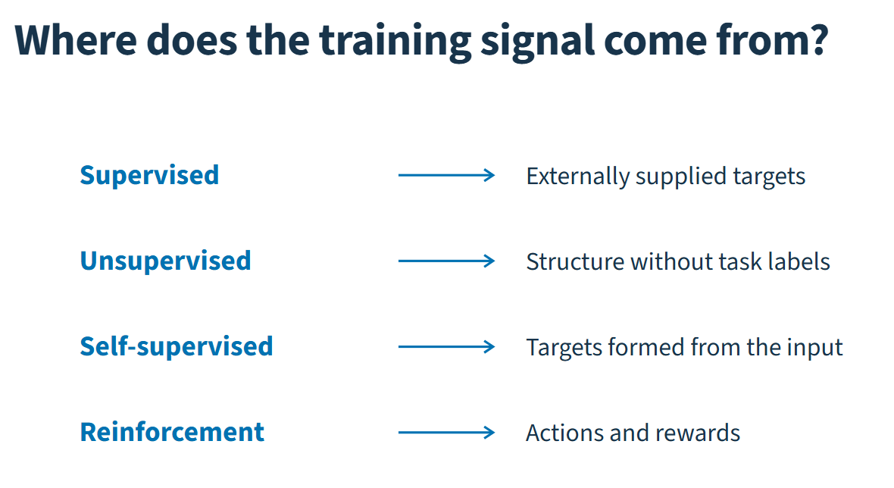

Slide 6
Days 1,2
Day 3

Slide 7
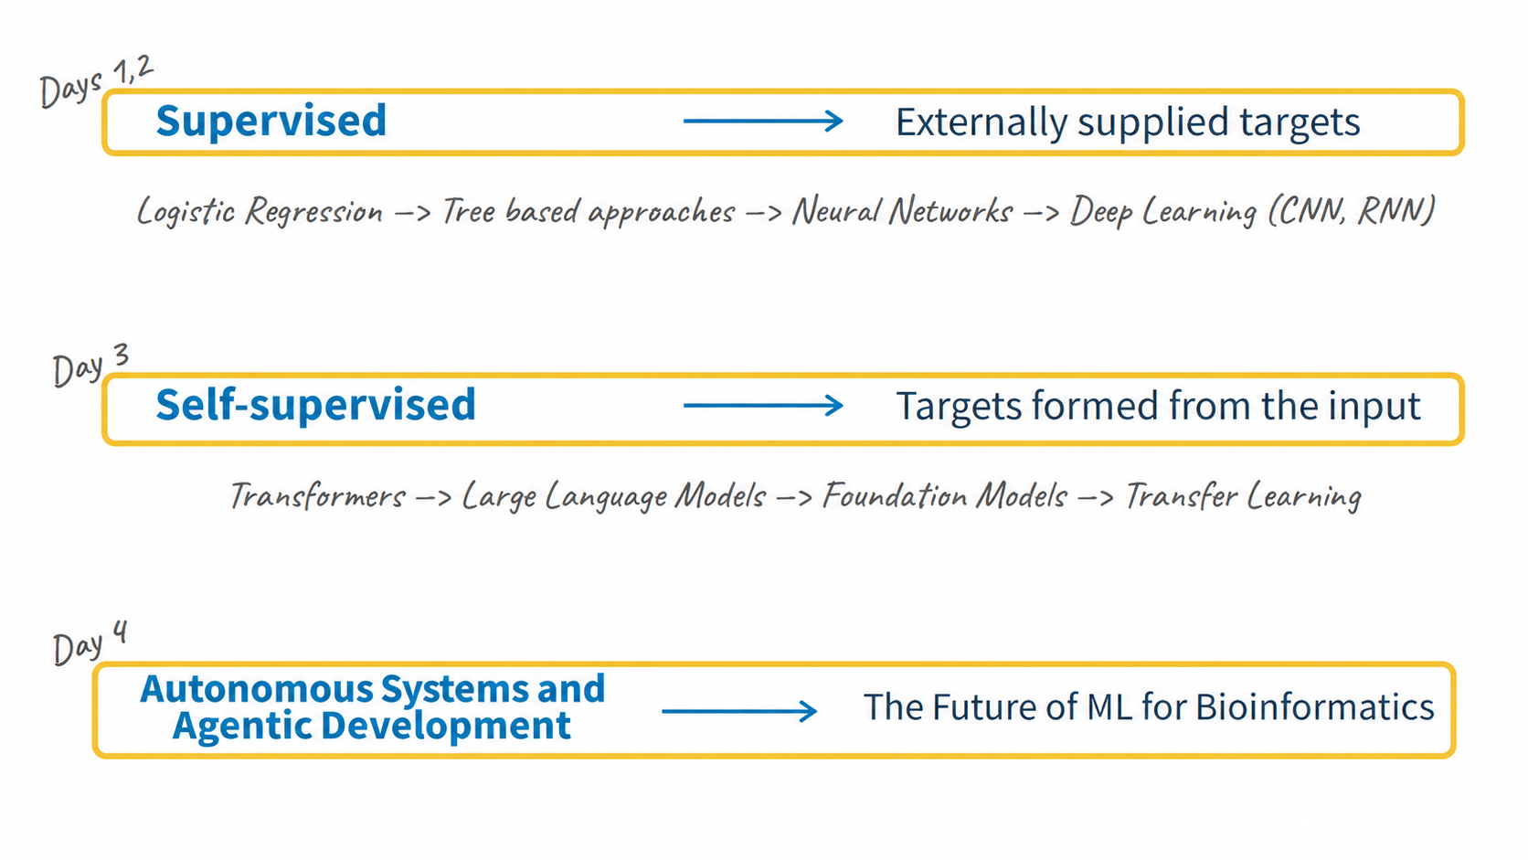

Slide 8
Task
Data
Modeling
Evaluation
Application

Slide 9
The Task dictates downstream steps
What is the question?
Task
Data
Modeling
Evaluation
Application

Slide 10
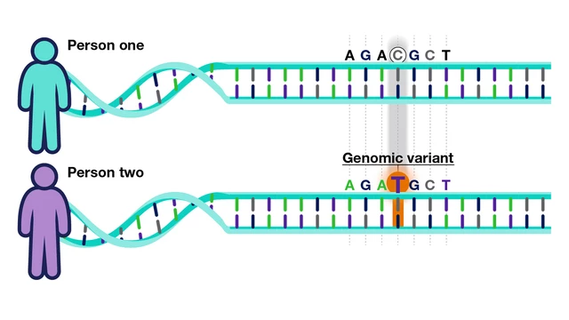
Classification
Is a variant pathogenic?
Yes / No
Output: Categorical value

Slide 11
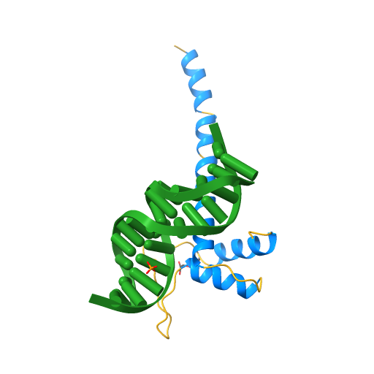
Regression
Transcription factor
MEEPQSDPSVEP
How does its knockdown affect gene expression of a gene X in a cell line Y?
-100
-10
0
10
100
Output: Continuous value

Slide 12
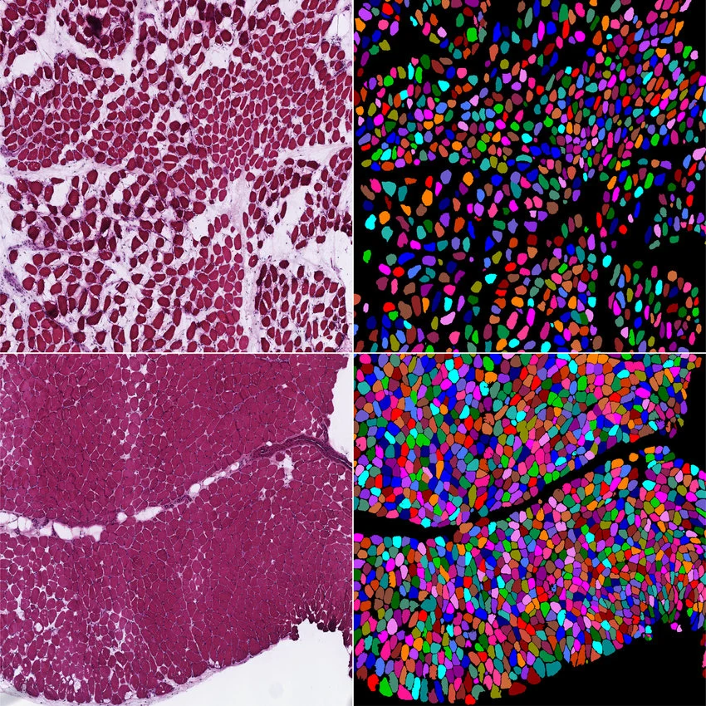
Segmentation
Which pixels are cells? (Semantic)
Which pixels are cell1, cell2, … ? (Instance)
Labels: cell, background, boundary
Basically per-pixel classification
Output: Per-pixel categorical value

Slide 13
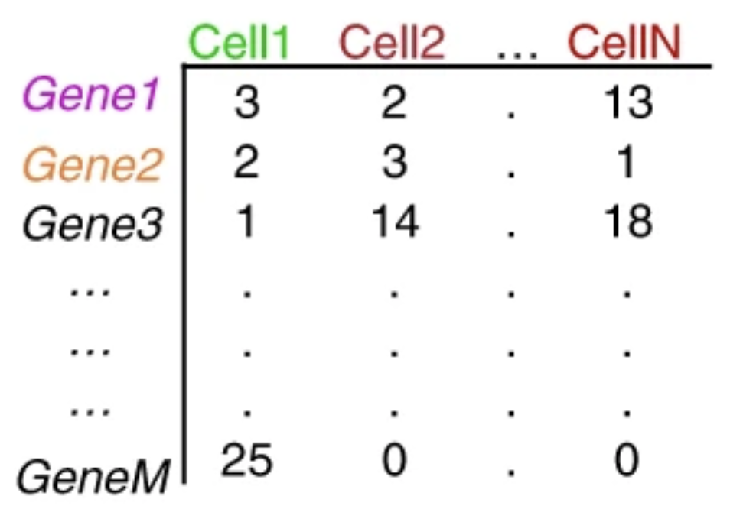
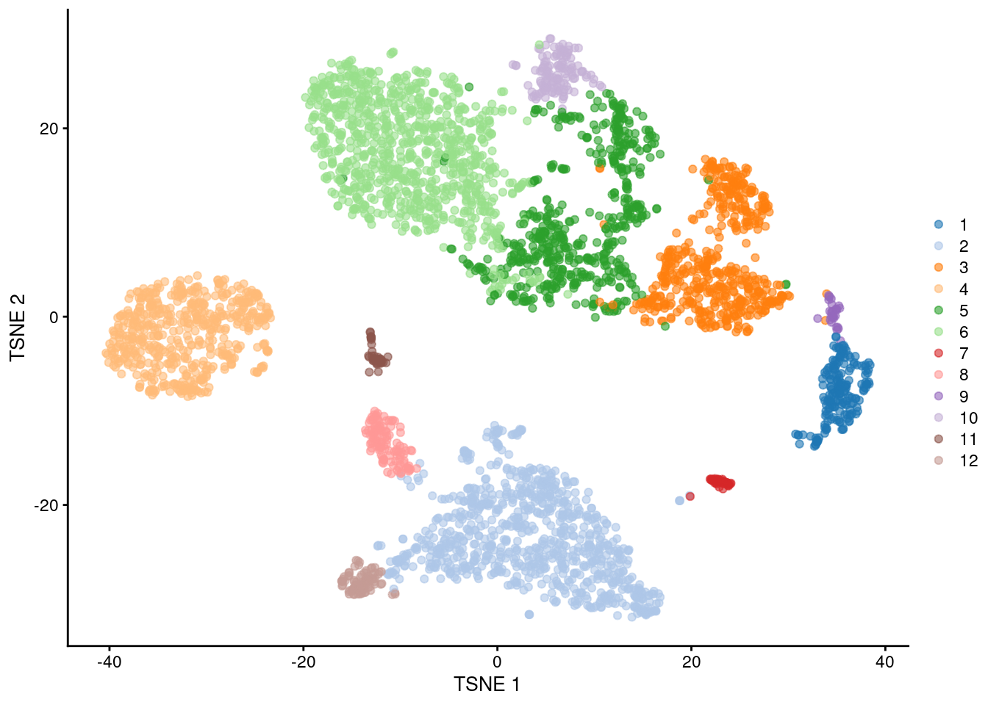
Clustering
Which cells are of the same type?
Output: Cluster assignments

Slide 14
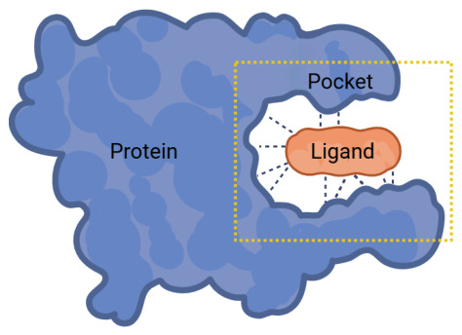
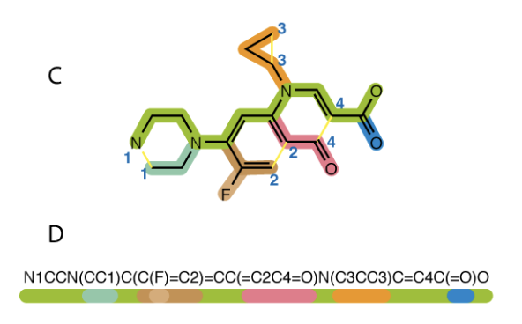
Generation
Generate a novel small molecule that binds to this protein
Output: Molecule SMILES

Slide 15
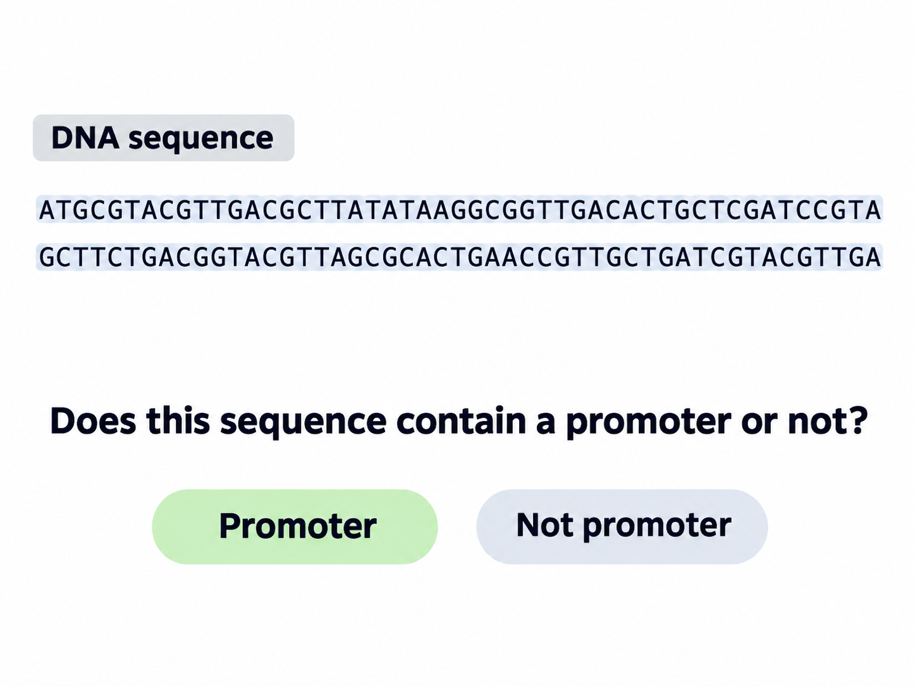
What type of Task is this?

Slide 16
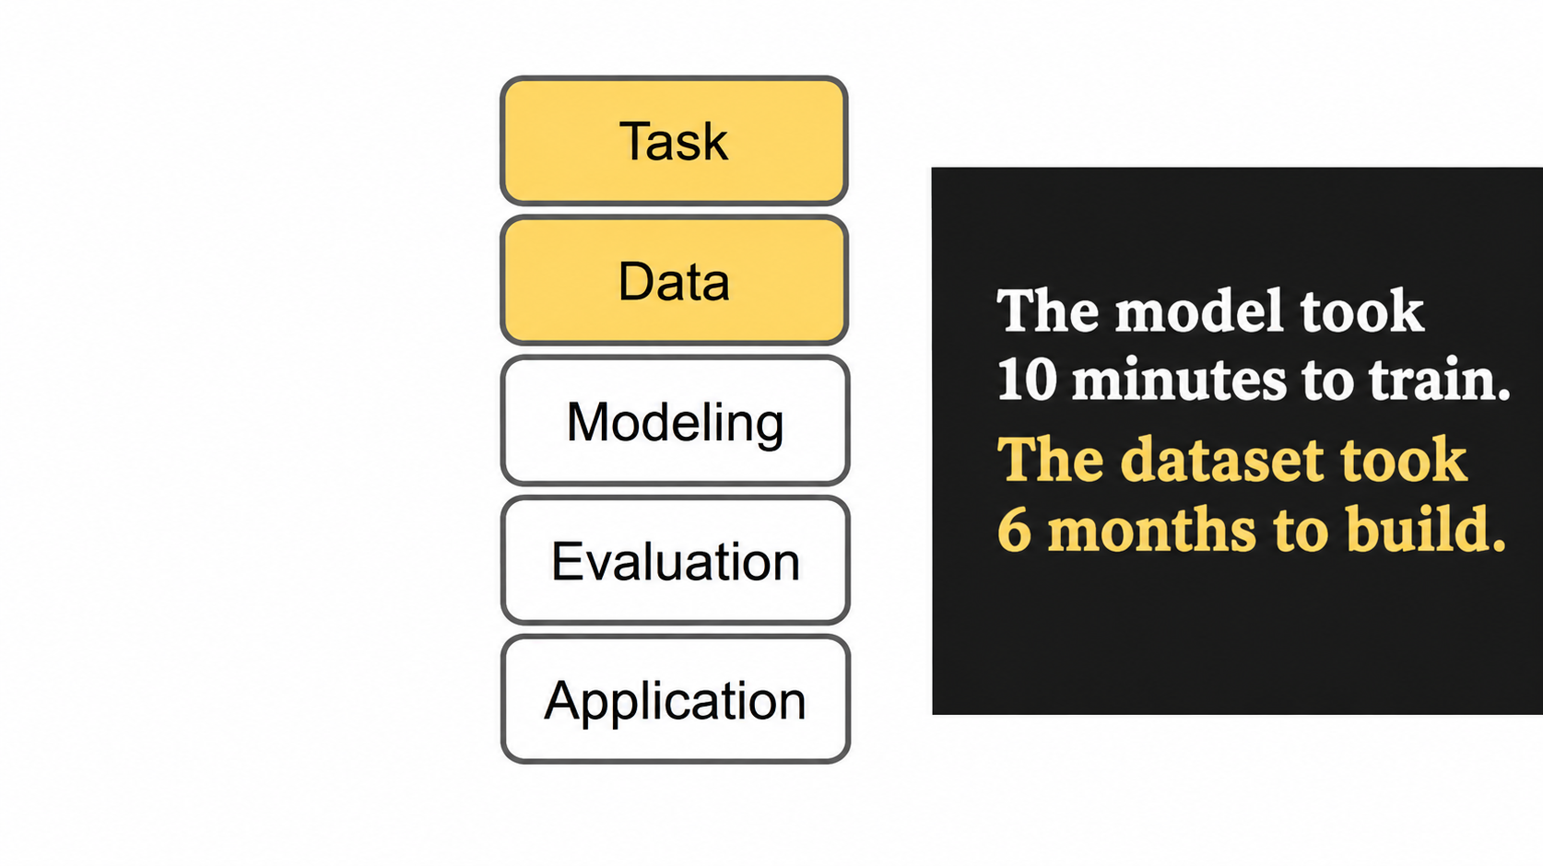

Slide 17
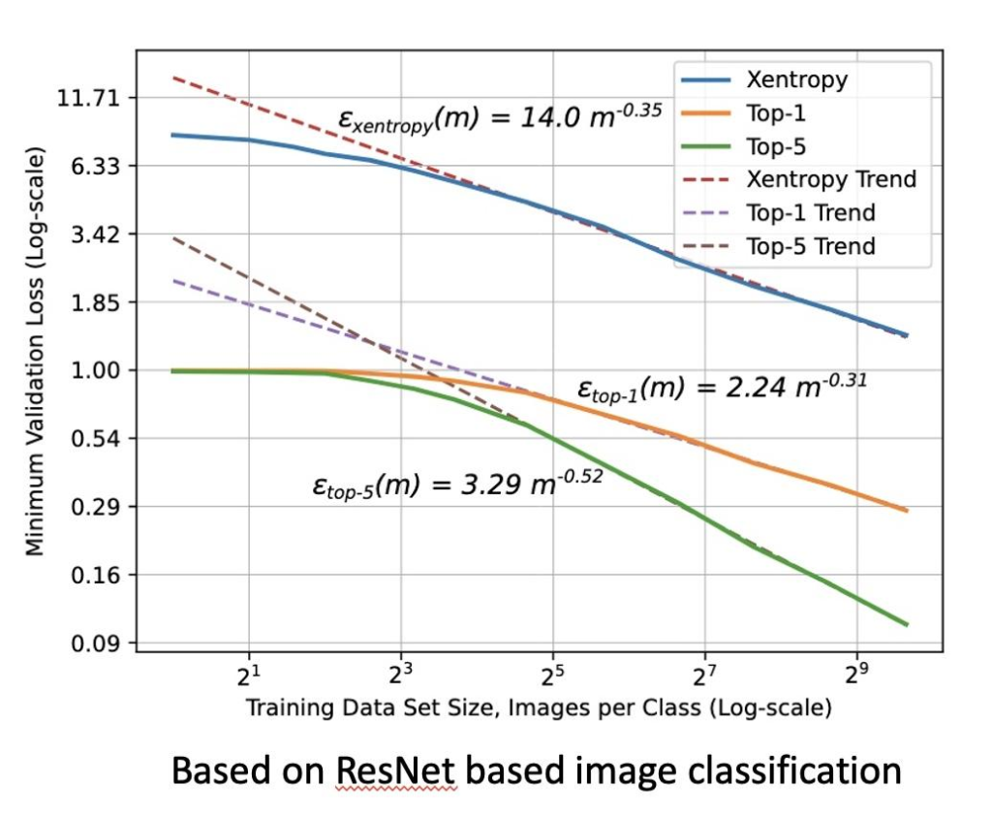
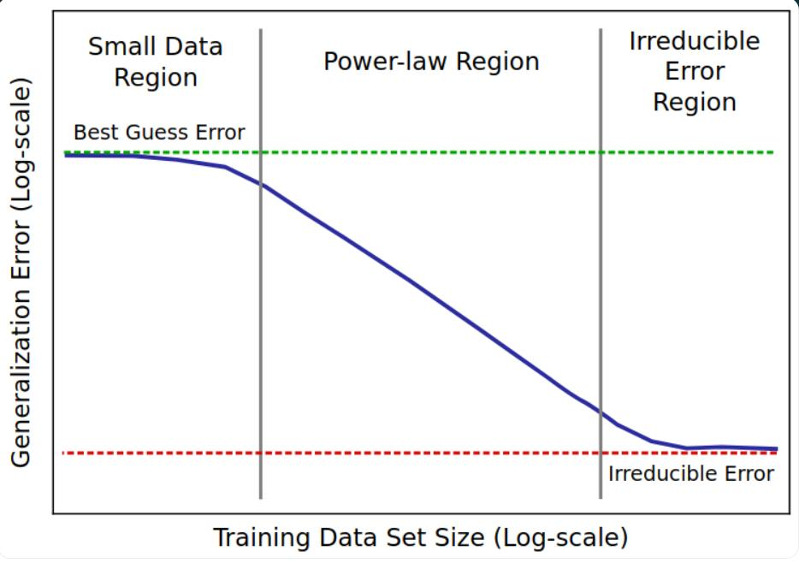
Data quantity
https://arxiv.org/abs/1712.00409

Slide 18
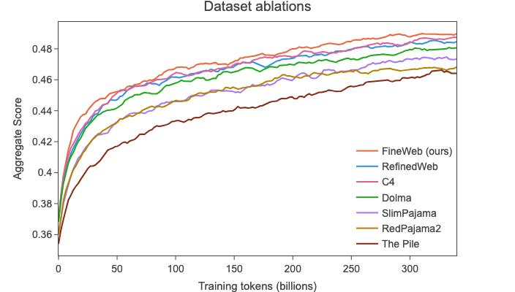
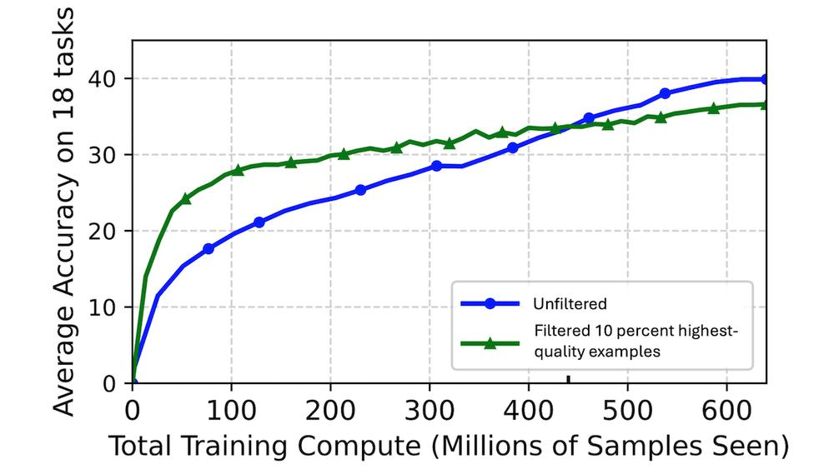
Data quality
Informativeness
Label correctness
Domain coverage
Balance
Harmonizing different sources
Quantity still matters
https://arxiv.org/abs/2406.17557

Slide 19
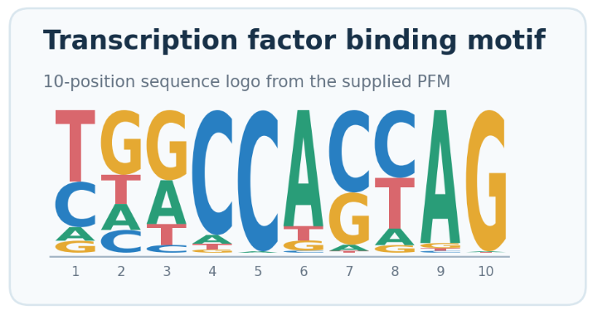
Let’s create a dataset
We will work on artificial data, so we know exactly what is in the dataset
We will simulate a TFBS motif
Positives: 10,000 sequences of 100nt each incl. motif
Negatives: 10,000 sequences of 100nt each
Exercise 1
https://github.com/palexiou/ML_Course_2026

Slide 20
Task
Data
Modeling
Evaluation
Application

Slide 21
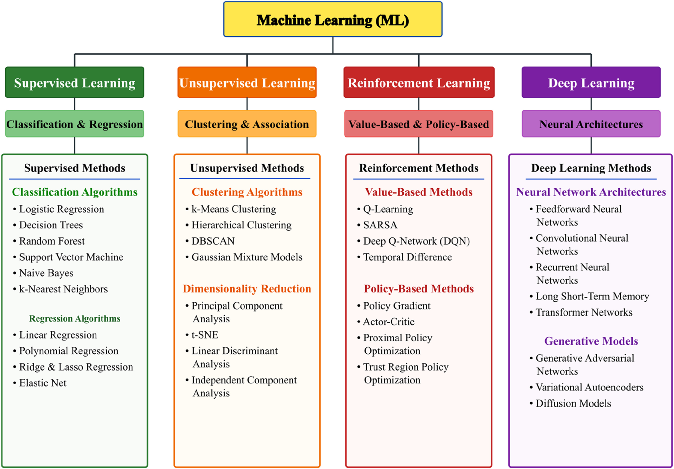

Slide 22
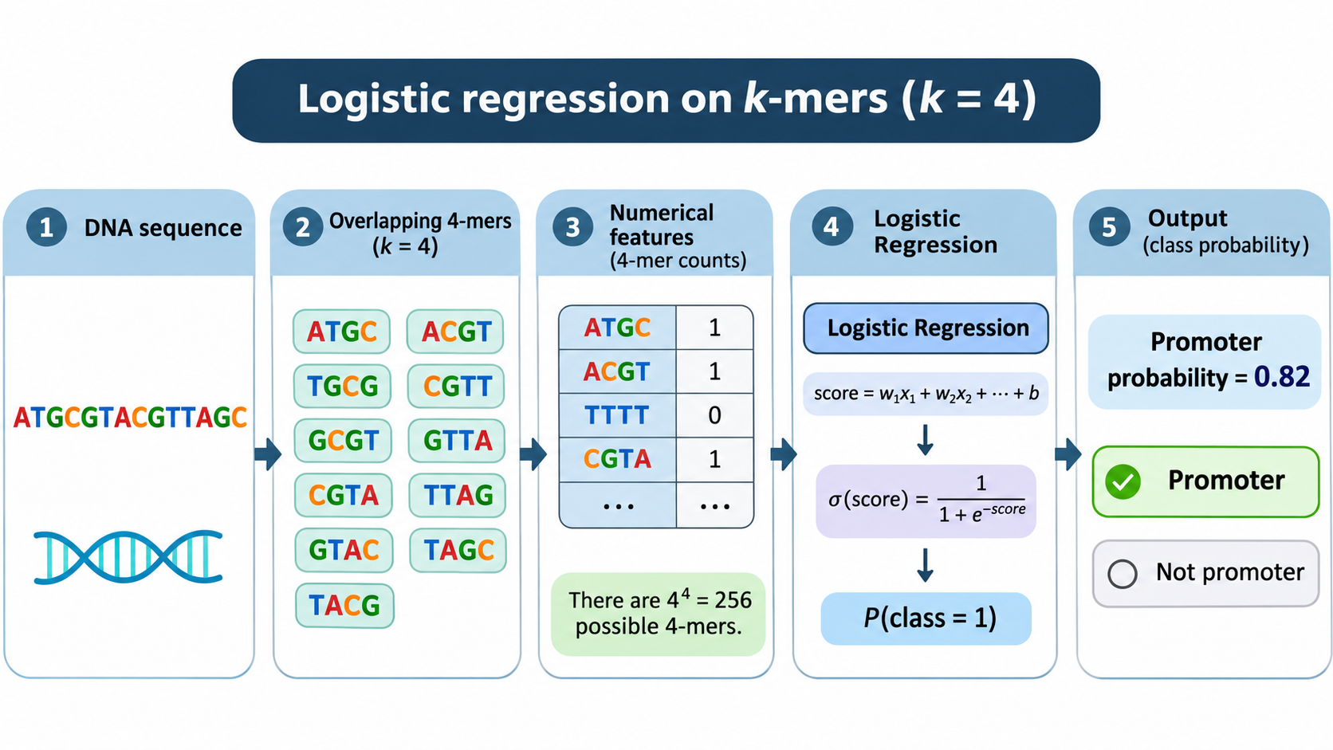

Slide 23
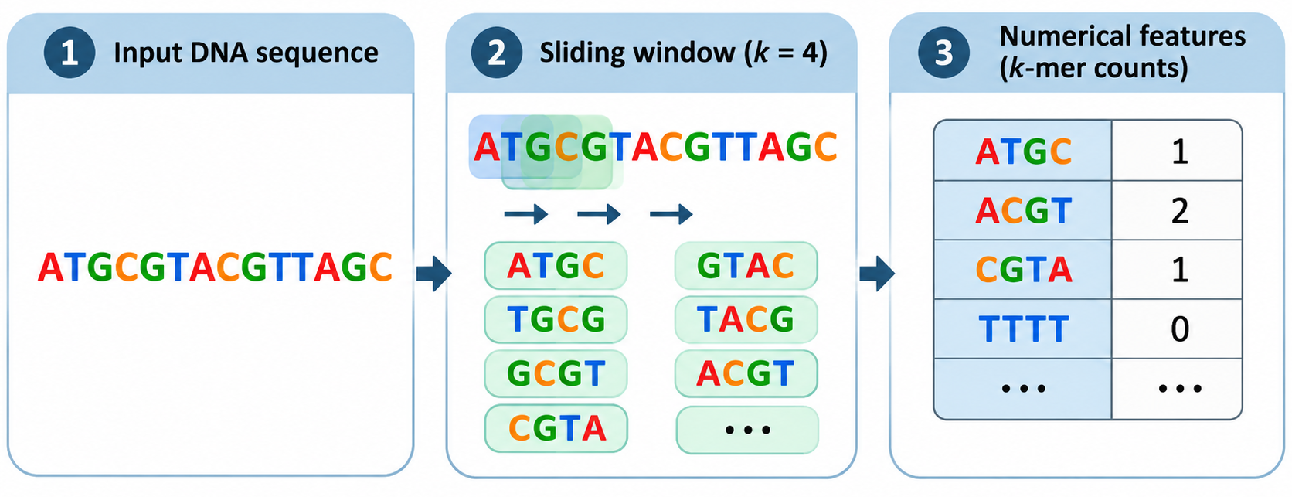
From DNA sequence → bag of k-mers.
Is this a good representation of the DNA sequence? (Discuss Representation)

Slide 24
Task
Data
Modeling
Evaluation
Application

Slide 25
Is your model good enough?
Available data
Trained Model
Predictions
New data
Trained Model
Predictions

Slide 26
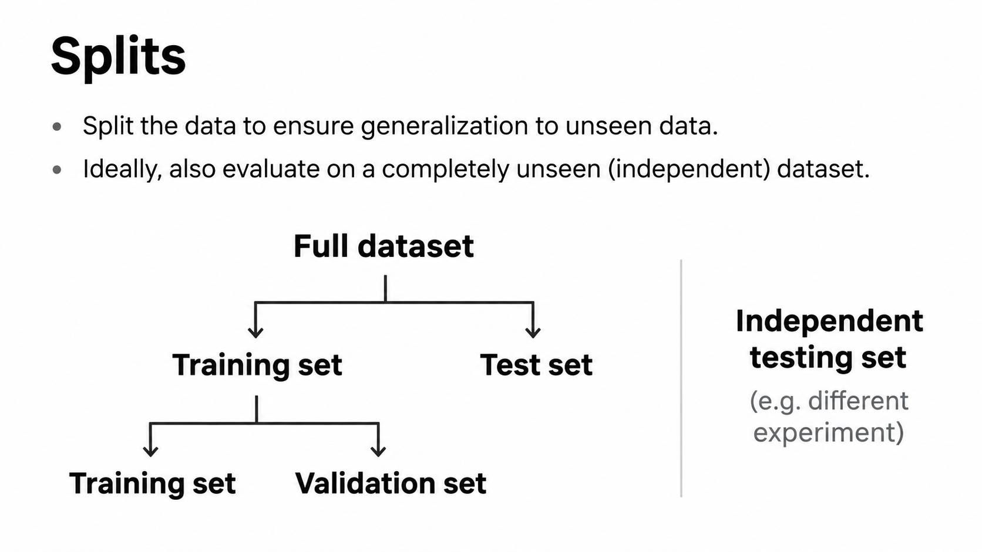

Slide 27
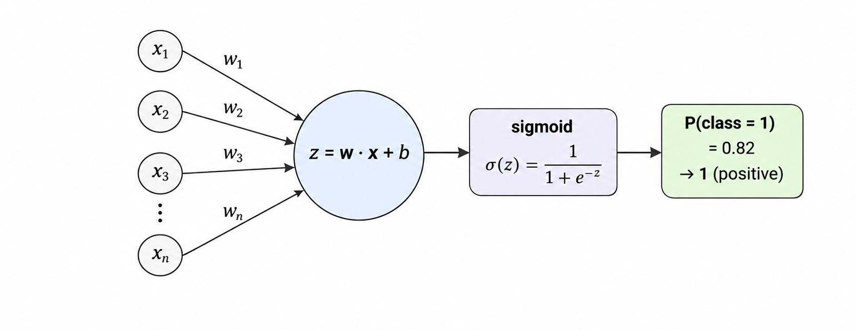
Logistic Regression
Logistic regression is mathematically equivalent to a single artificial neuron with a sigmoid activation function

Slide 28
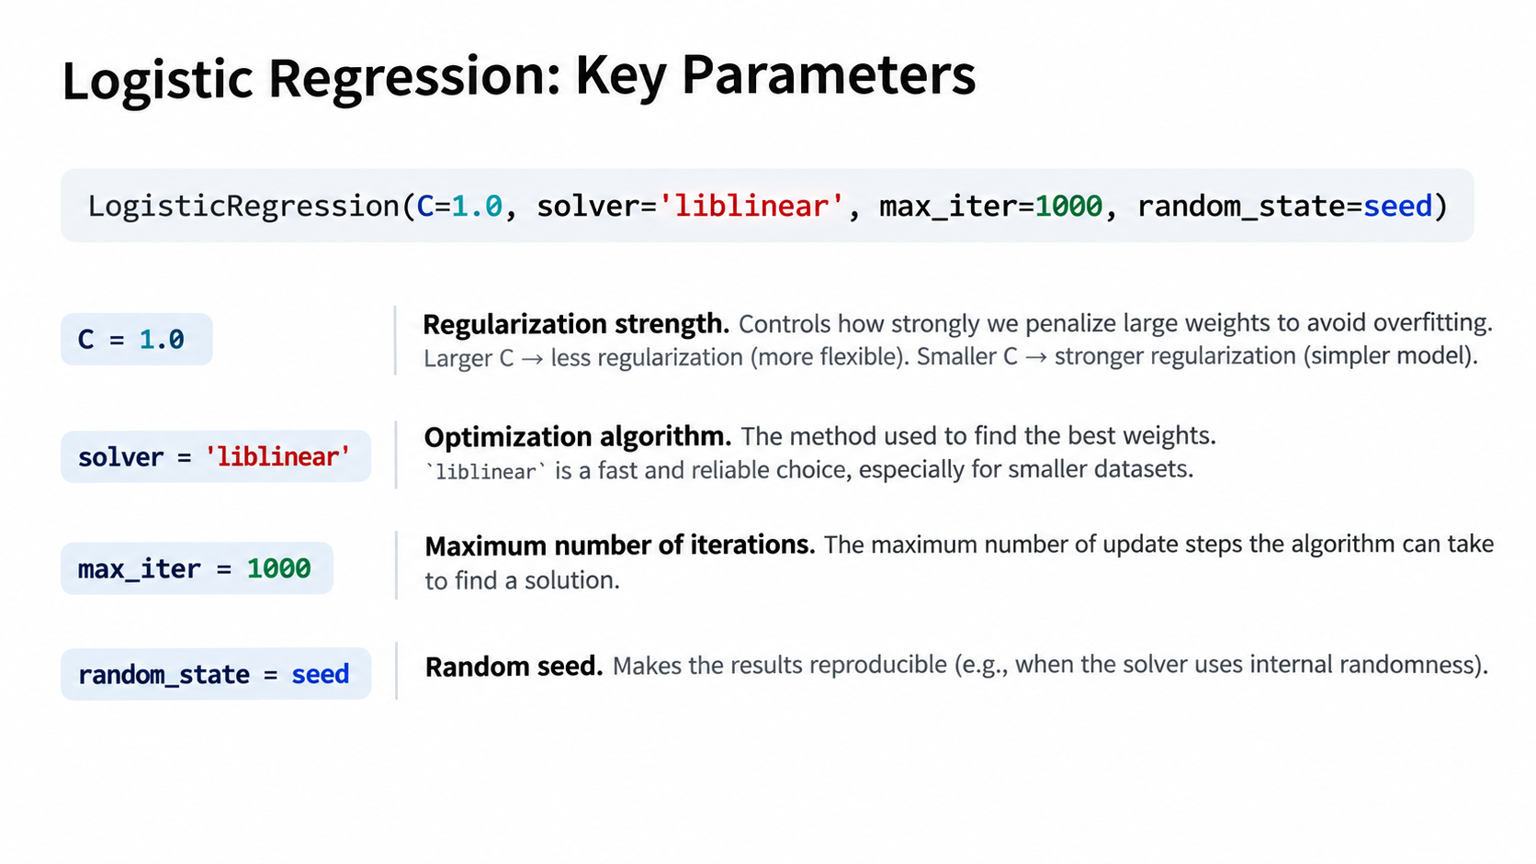

Slide 29
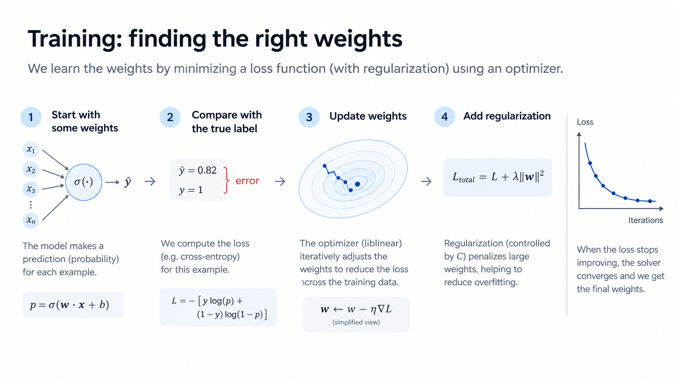

Slide 30
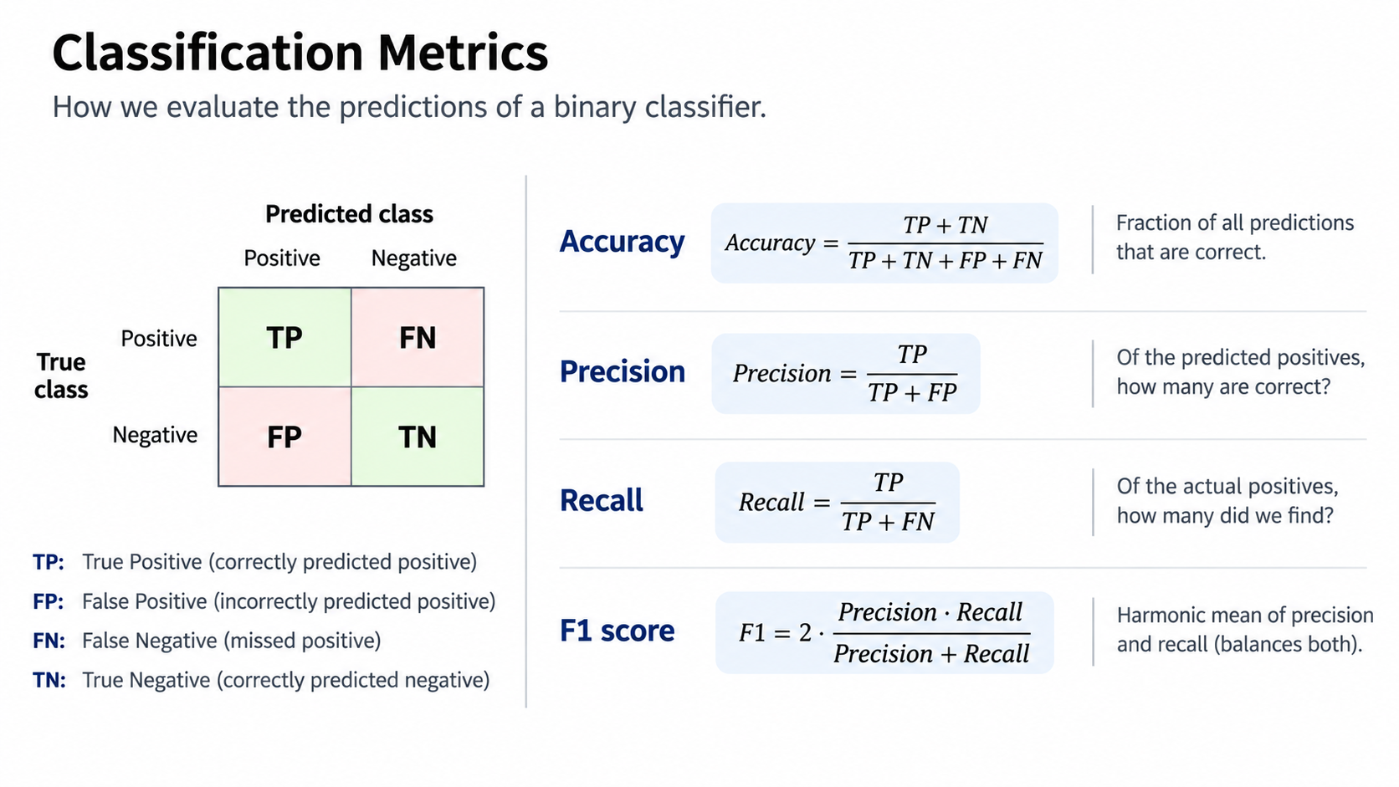

Slide 31
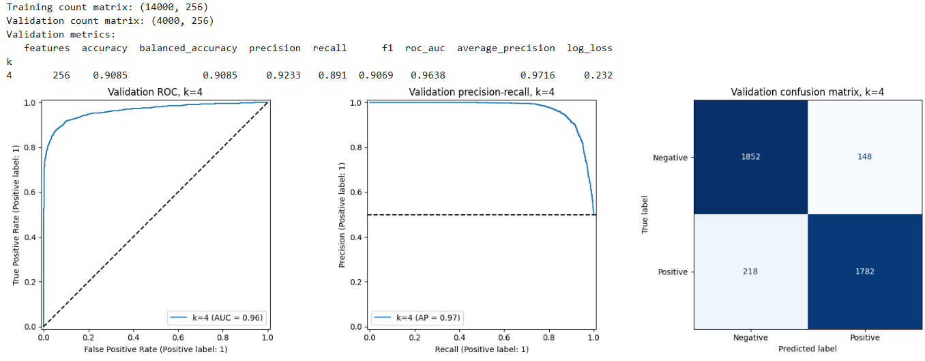
What do these metrics mean?

Slide 32
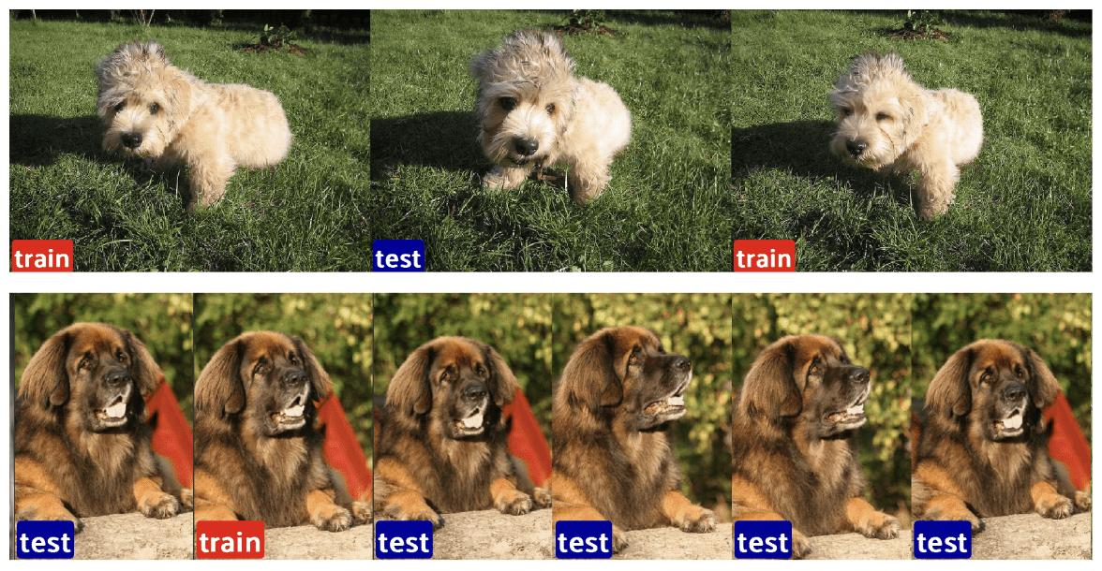
A common pitfall: Data leakage
Direct:
Model input contains answer
Test sample is an exact train duplicate
Indirect (Depends on the task):
Same patient data
Same celltype
https://voxel51.com/blog/on-leaky-datasets-and-a-clever-horse

Slide 33
Task
Data
Modeling
Evaluation
Application

Slide 34
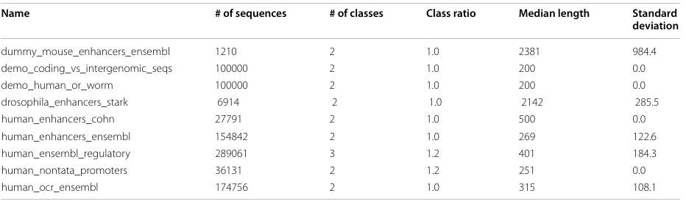

Exercise notebook 3
How to deal with real world problems (test N)

Slide 35


Slide 36
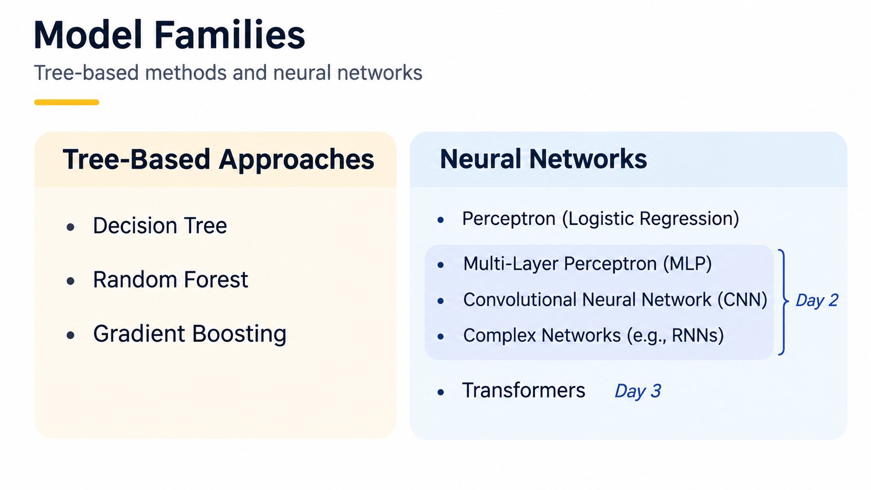


Slide 37
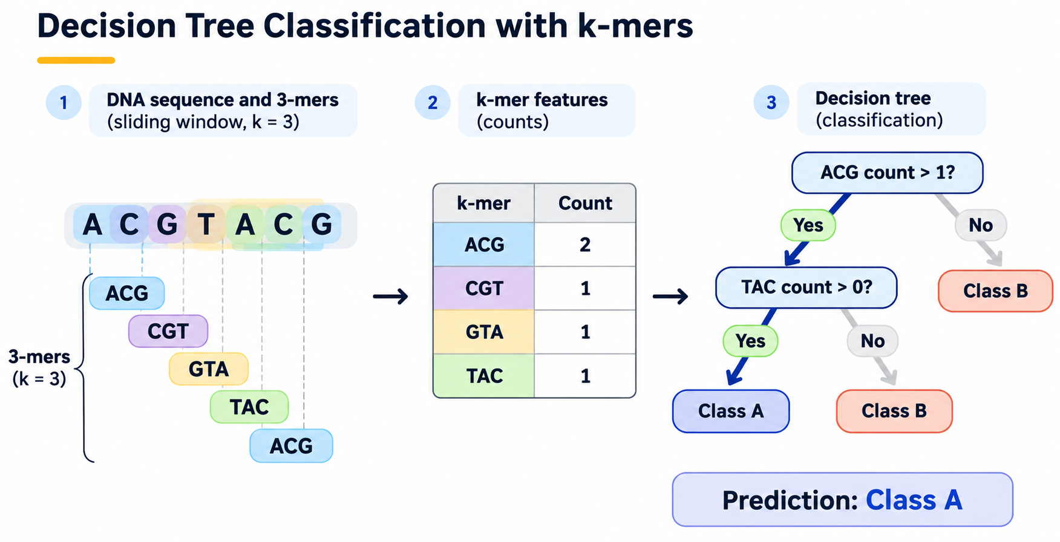
Which are the best questions to ask to make decision? (criterion="gini" )

Slide 38
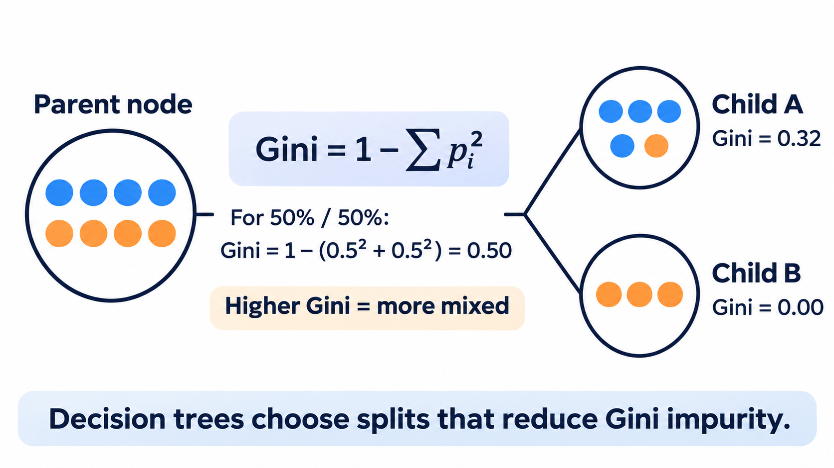

Slide 39
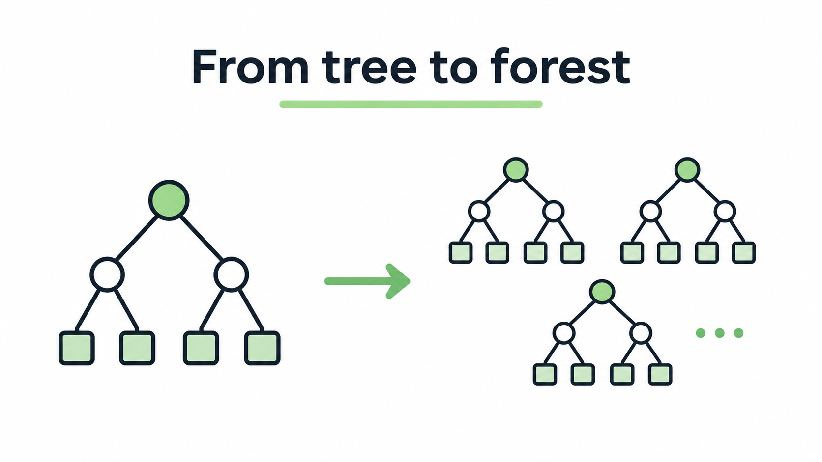

Slide 40
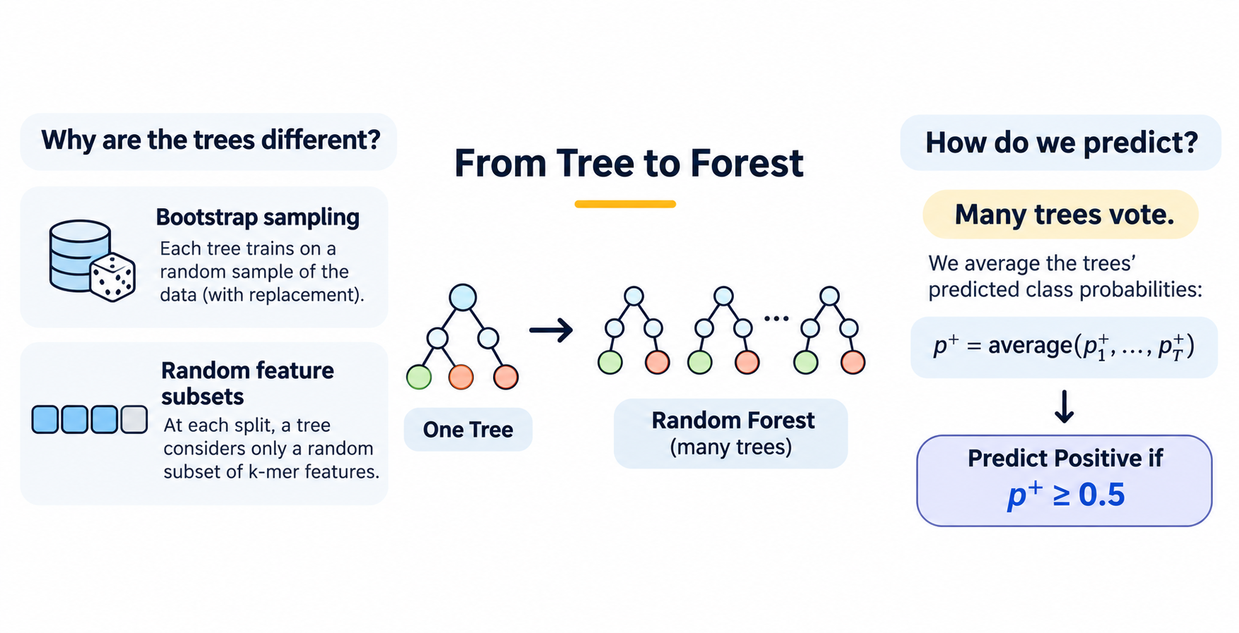

Slide 41
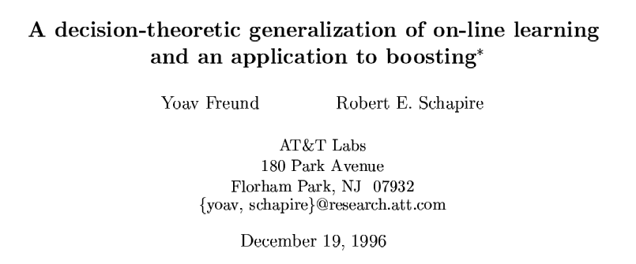
Boosting

Slide 42
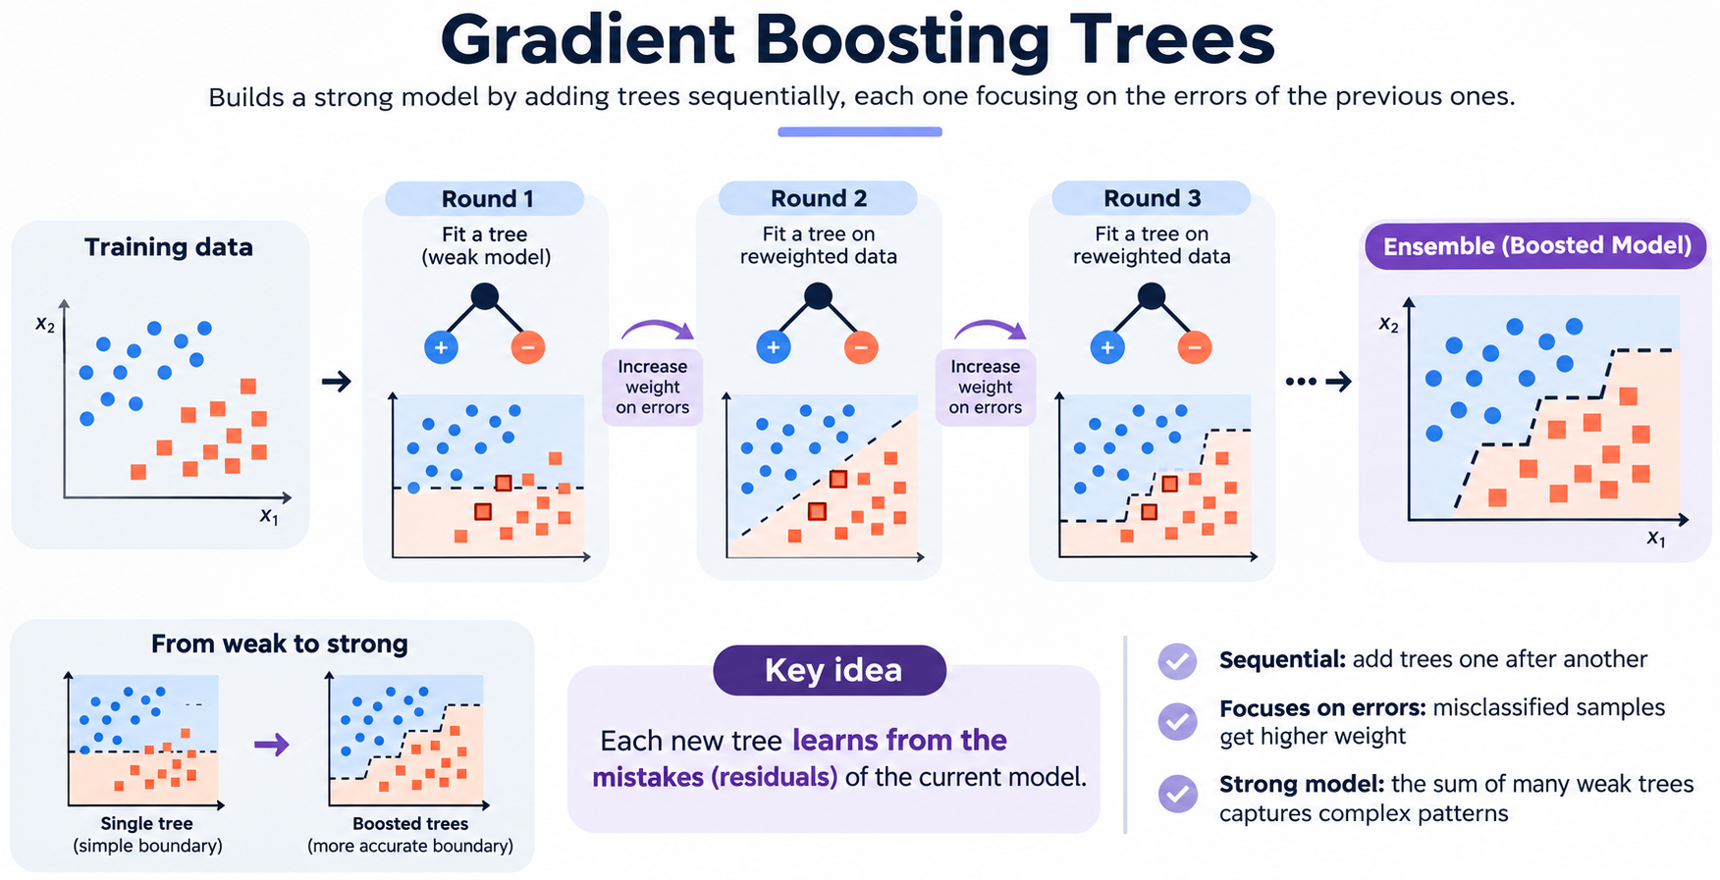

Slide 44

ML is complex + builds on top of data science
Data is the difficult boring part that matters most
Not everything is a ML problem
Look for existing solutions

